Slide 1

PROJECT REPORT
Under The Guidance Of
Mr. Parth Paul
TATA MOTORS LIMITED, LUCKNOW
Submitted By-
Name-PRATEEK RATHORE
College-Dehradun Institue Of Technology , Dehradun,UK.
Duration: 4th Jul - 3rd Aug 2023

Slide 2
ACKNOWLEDGEMENT
I would like to take this opportunity to present my whole hearted compliments, regards and warm thanks to one and all, who played a direct/indirect role in ensuring the successful completion of the project under the stipulated time frame. This project has enhanced my knowledge and given me exposure to an interesting field of research, thus, allowing me to read, learn and come up with an innovative concept. First and foremost, I wish to thank my mentor Mr.Parth Paul of Tata Motors Limited Lucknow for his guidance, patience, and valuable views which has been an integral part to accomplish the work. His knowledge and consistent support played a necessary role in steering towards completion. He has been extremelyhelpful in always responding positively to my queries. Additionally, I thank him for evaluating my progress at different instances during this INTERNSHIP and providing with his valuable suggestions which has greatly influenced the work. It has been due to their faith in me that this endeavor has been a success. Finally, I am thankful to my parents and brother for supporting at all stages during these past months as well as helping to ensure steady growth in my work.

Slide 3
PROJECT TITLE: Registration Form using JDBC and Java Swings and Introduction to Computer Networks and Servers
Introduction:
While making of Registration form 4 tools were requires:
1. NEATBEANS-
NetBeans is an open-source integrated development environment (IDE) for developing with Java, PHP, C++, and other programming languages. NetBeans is also referred to as a platform of modular components used for developing Java desktop applications.
NetBeans is coded in Java and runs on most operating systems with a Java Virtual Machine (JVM), including Solaris, Mac OS, and Linux.
NetBeans manages the following platform features and components:
User settings
Windows (placement, appearance, etc.)
NetBeans Visual Library
Storage
Integrated development tools
Framework wizard
NetBeans uses components, also known as modules, to enable software development. NetBeans dynamically installs modules and allows users to download updated features and digitally authenticated upgrades.
NetBeans IDE modules include NetBeans Profiler, a Graphical User Interface (GUI) design tool, and NetBeans JavaScript Editor.
NetBeans framework reusability simplifies Java Swing desktop application development, which provides platform extension capabilities to third-party developers.

Slide 4
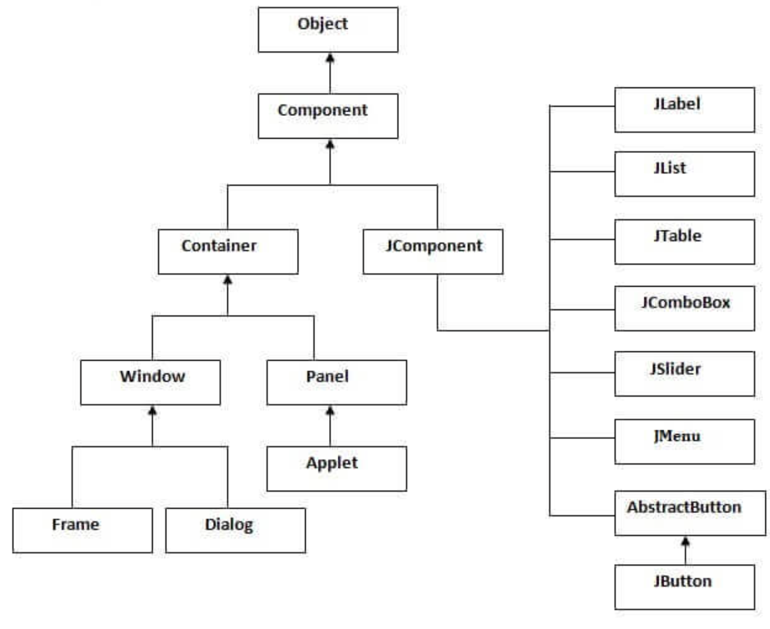
2. JAVA SWINGS-
Java Swing tutorial is a part of Java Foundation Classes (JFC) that is used to create window-based applications. It is built on the top of AWT (Abstract Windowing Toolkit) API and entirely written in java.
Unlike AWT, Java Swing provides platform-independent and lightweight components.
The javax.swing package provides classes for java swing API such as JButton, JTextField, JTextArea, JRadioButton, JCheckbox, JMenu, JColorChooser etc.
The hierarchy of java swing API is given below.

Slide 5
The methods of Component class are widely used in java swing that are given below.
Method | Description
public void add(Component c) | add a component on another component.
public void setSize(int width,int height) | sets size of the component.
public void setLayout(LayoutManager m) | sets the layout manager for the component.
public void setVisible(boolean b) | sets the visibility of the component. It is by default false.

Slide 6
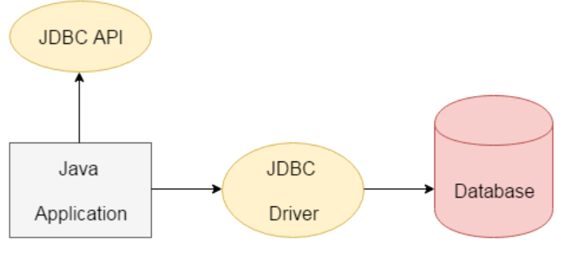
3. JAVA DATABASE CONNECTIVITY(JDBC)
JDBC stands for Java Database Connectivity. JDBC is a Java API to connect and execute the query with the database. It is a part of JavaSE (Java Standard Edition). JDBC API uses JDBC drivers to connect with the database. There are four types of JDBC drivers:
JDBC-ODBC Bridge Driver,
Native Driver,
Network Protocol Driver, and
Thin Driver
We can use JDBC API to access tabular data stored in any relational database. By the help of JDBC API, we can save, update, delete and fetch data from the database. It is like Open Database Connectivity (ODBC) provided by Microsoft.
The java.sql package contains classes and interfaces for JDBC API. A list of popular interfaces of JDBC API are given below:
Driver interface
Connection interface
Statement interface
PreparedStatement interface
CallableStatement interface
ResultSet interface
ResultSetMetaData interface
DatabaseMetaData interface
RowSet interface
A list of popular classes of JDBC API are given below:
DriverManager class
Blob class
Clob class
Types class

Slide 7

4. MySql (database)
MySQL is the world’s most popular open source database. According to DB-Engines, MySQL ranks as the second-most-popular database, behind Oracle Database. MySQL powers many of the most accessed applications, including Facebook, Twitter, Netflix, Uber, Airbnb, Shopify, and Booking.com.
MySQL is a relational database management system
Databases are the essential data repository for all software applications. For example, whenever someone conducts a web search, logs in to an account, or completes a transaction, a database system is storing the information so it can be accessed in the future.
A relational database stores data in separate tables rather than putting all the data in one big storeroom. The database structure is organized into physical files optimized for speed. The logical data model, with objects such as data tables, views, rows, and columns, offers a flexible programming environment. You set up rules governing the relationships between different data fields, such as one to one, one to many, unique, required, or optional, and “pointers” between different tables. The database enforces these rules so that with a well-designed database your application never sees data that’s inconsistent, duplicated, orphaned, out of date, or missing.
MySQL benefits
MySQL is fast, reliable, scalable, and easy to use. It was originally developed to handle large databases quickly and has been used in highly demanding production environments for many years.
Although MySQL is under constant development, it offers a rich and useful set of functions. MySQL’s connectivity, speed, and security make it highly suited for accessing databases on the internet.
MySQL’s key benefits include
Ease of use: Developers can install MySQL in minutes, and the database is easy to manage.
Reliability: MySQL is one of the most mature and widely used databases. It has been tested in a wide variety of scenarios for more than 25 years, including by many of the world’s largest companies. Organizations depend on MySQL to run business-critical applications because of its reliability.
Scalability: MySQL scales to meet the demands of the most accessed applications. MySQL’s native replication architecture enables organizations such as Facebook to scale applications to support billions of users.
Performance: MySQL HeatWave is faster and less expensive than other database services, as demonstrated by multiple standard industry benchmarks, including TPC-H, TPC-DS, and CH-benCHmark.
High availability: MySQL delivers a complete set of native, fully integrated replication technologies for high availability and disaster recovery. For business-critical applications, and to meet service-level agreement commitments, customers can achieve
Recovery point objective = 0 (zero data loss)
Recovery time objective = seconds (automatic failover)
Security: Data security entails protection and compliance with industry and government regulations, including the European Union General Data Protection Regulation, the Payment Card Industry Data Security Standard, the Health Insurance Portability and Accountability Act, and the Defense Information Systems Agency’s Security Technical Implementation Guides. MySQL Enterprise Edition provides advanced security features, including authentication/authorization, transparent data encryption, auditing, data masking, and a database firewall.

Slide 8
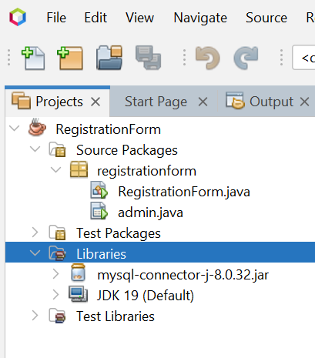
Steps to develop Registration Form in Java Swing is as below
Create a project named Registration form and add JAR file
Create User Interface (UI) Using Jframe and Collect data
Validate and Process Received data
Create Database and table in MySql
Link Database with Java Swing
Saving data to MySql Database
7. Create second frame named Login to extract data from database
Create a project named Registration form and JAR file-
Here we created a project named RegistrationForm that has 2 source packages RegistrationForm.java and Admin.java.
We have also added an external Jar file that is mysql-connector-jar-5.1.14-bin.jar. This jar file helps us to connect our java code with mysql database to perform different queries like insertion, deletion and selection.

Slide 9
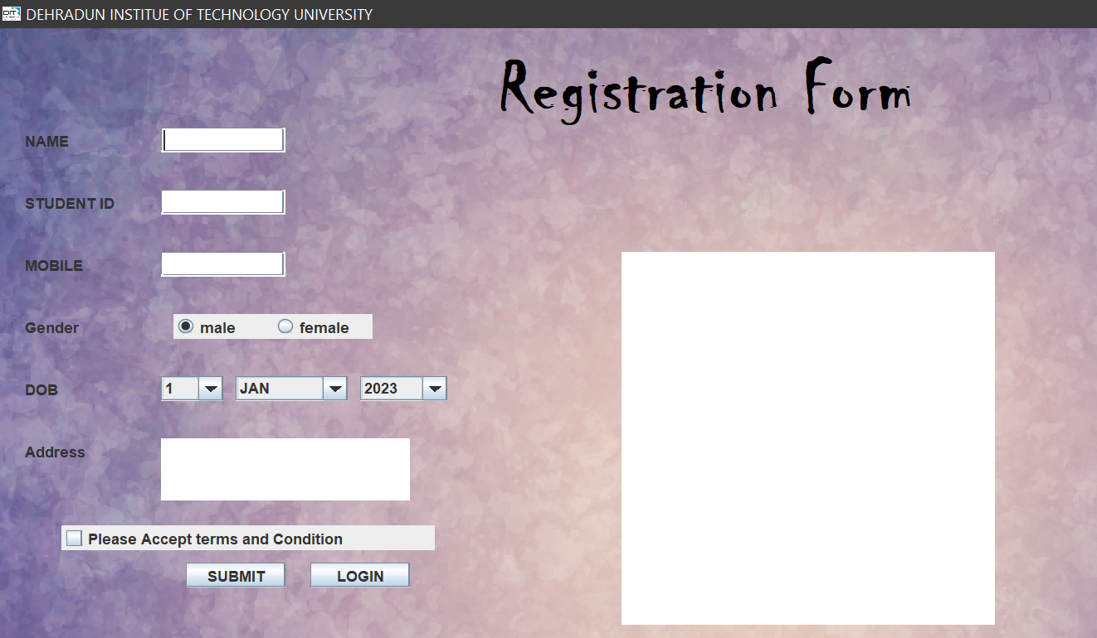
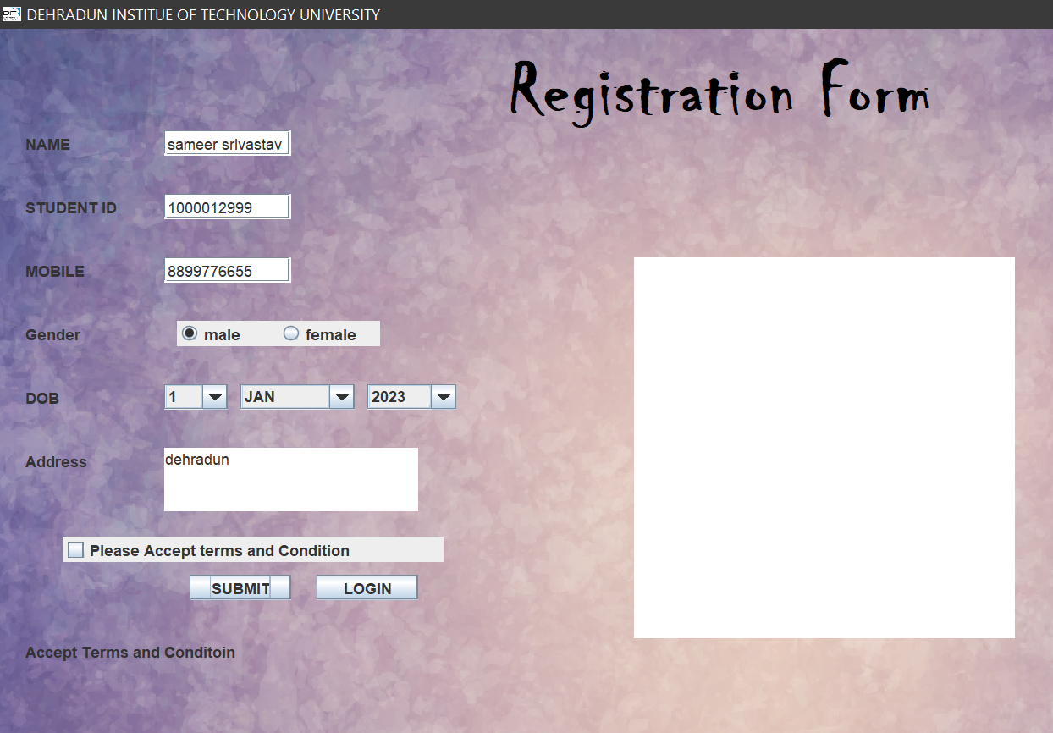
2. Create User Interface (UI) Using JFrame and Collect data
3. Validate and Process Received data
Case-1
If user don’t accept term and condition than the error will occur showing please accept terms and condition.

Slide 10
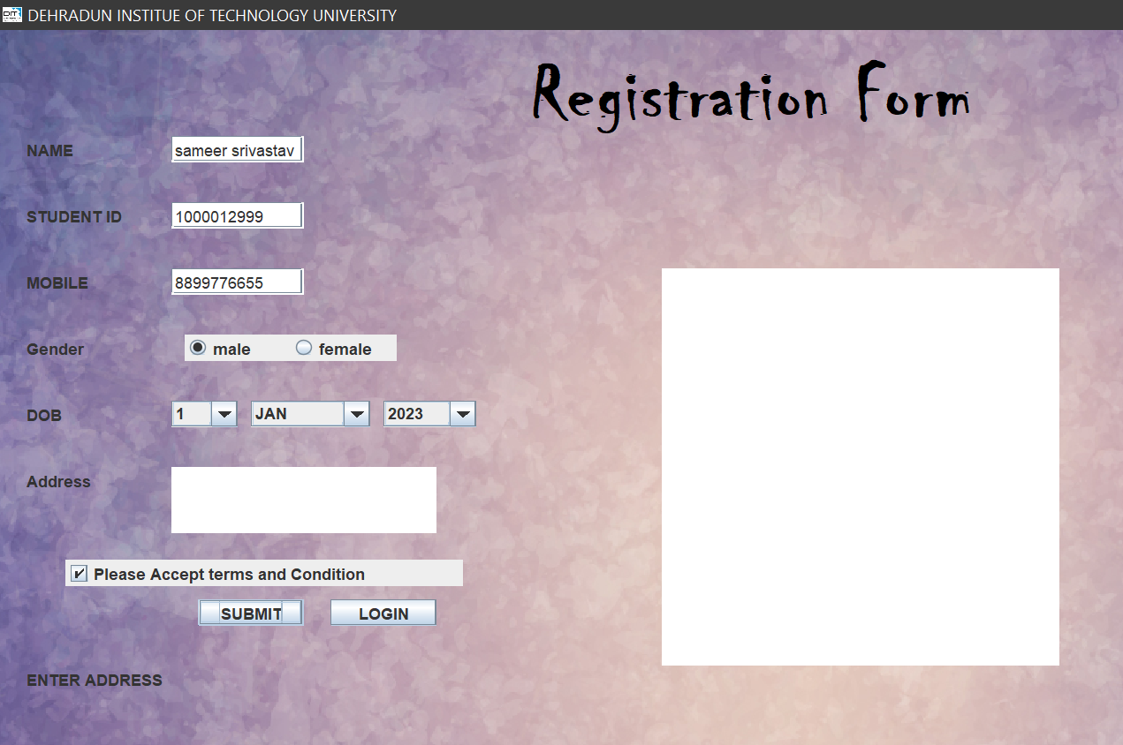
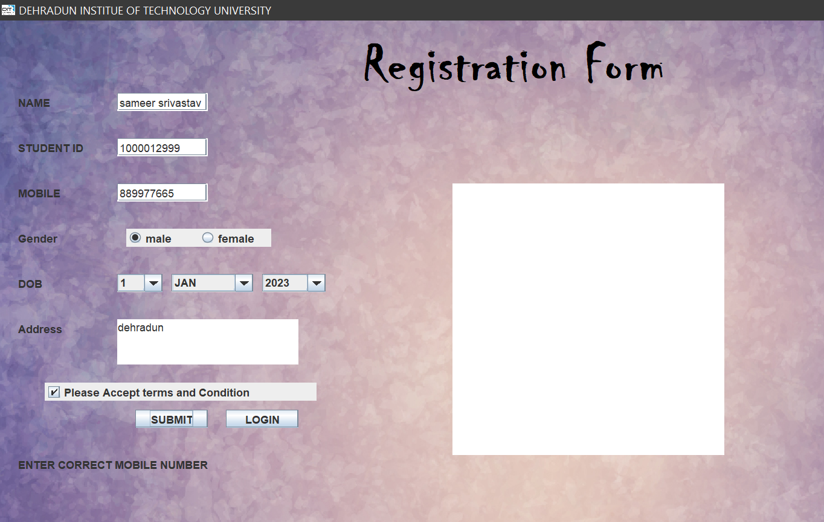
CASE 2-
If someone has not entered the address than it will show please enter address.
CASE 3-
If someone has entered the wrong number than it will show please enter correct number.

Slide 11
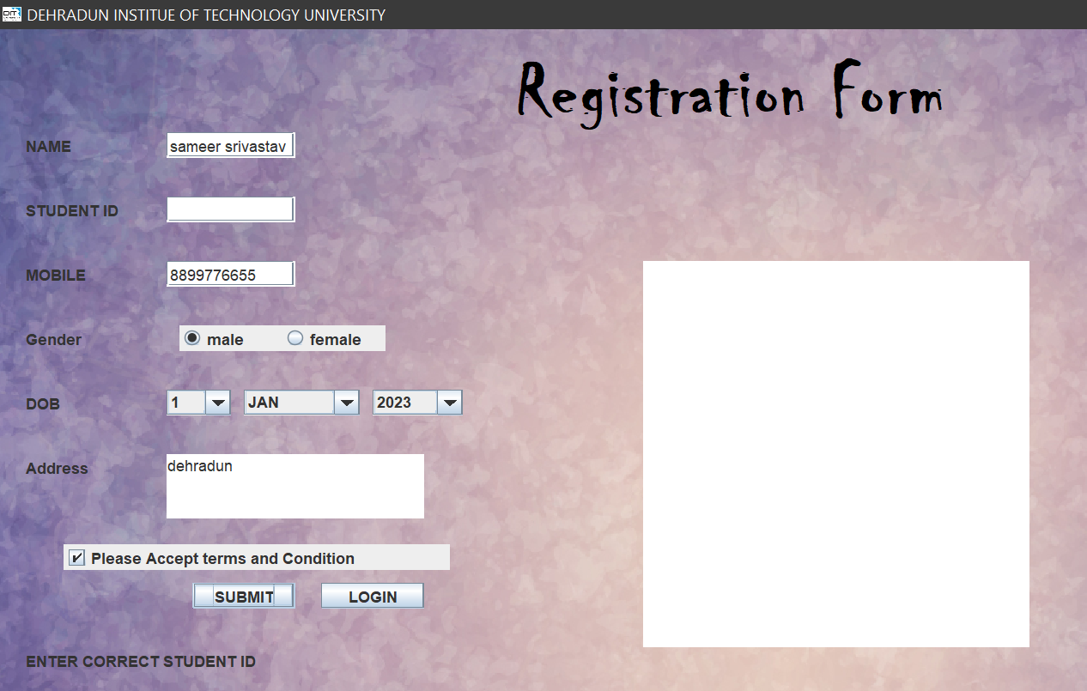
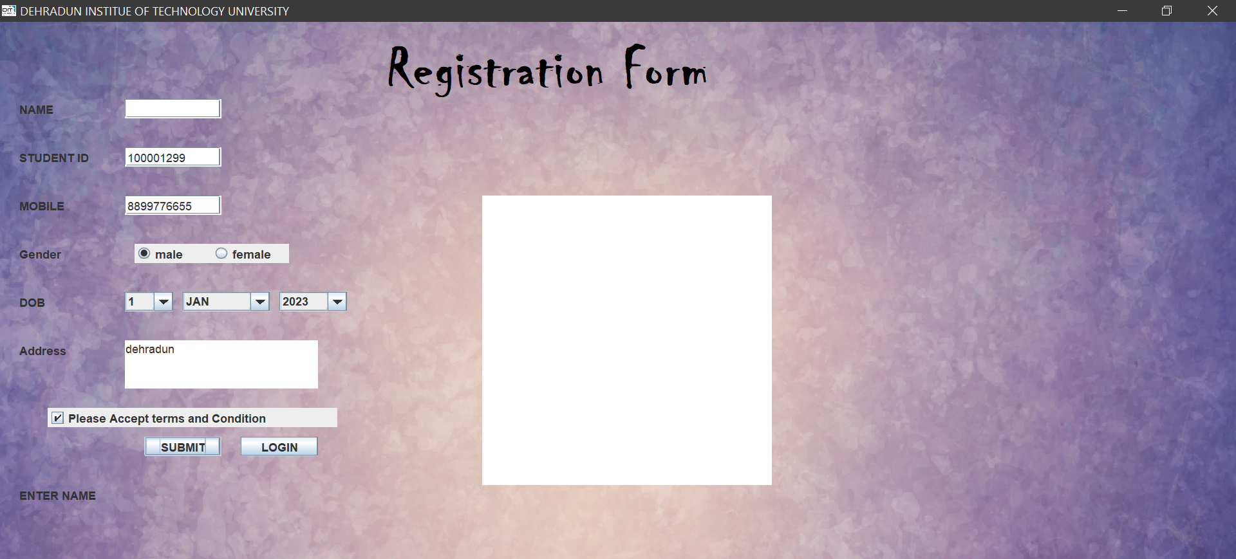
CASE 4-
If someone has not entered the correct Student ID than it will show please correct Student ID.
CASE 5-
If someone has not entered the correct name or has Forgot than it will show please enter name.

Slide 12
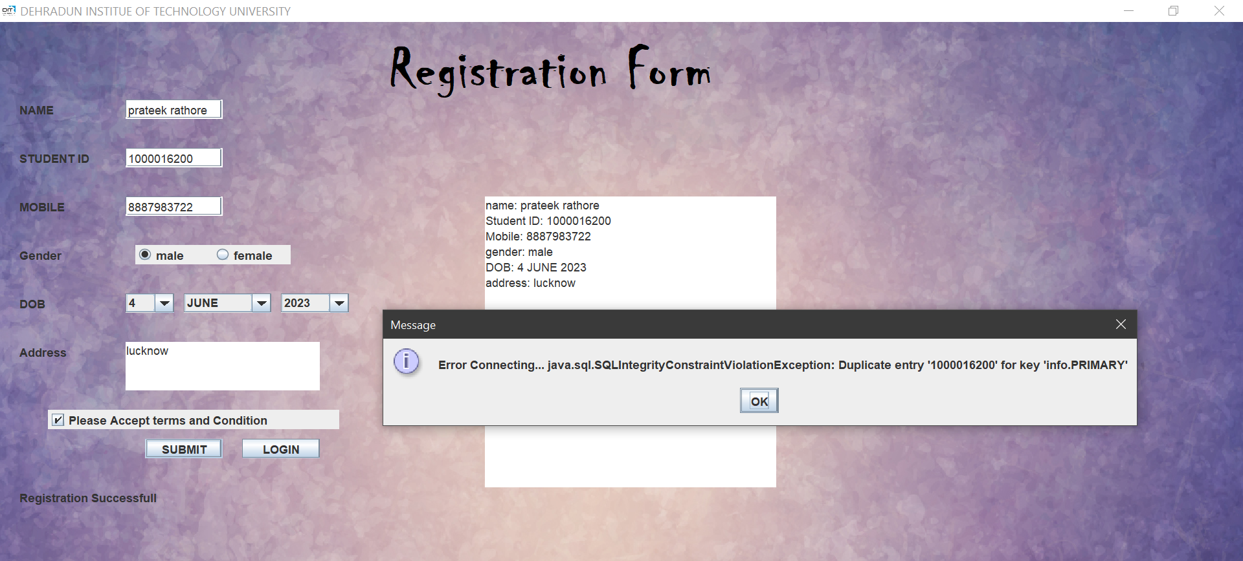
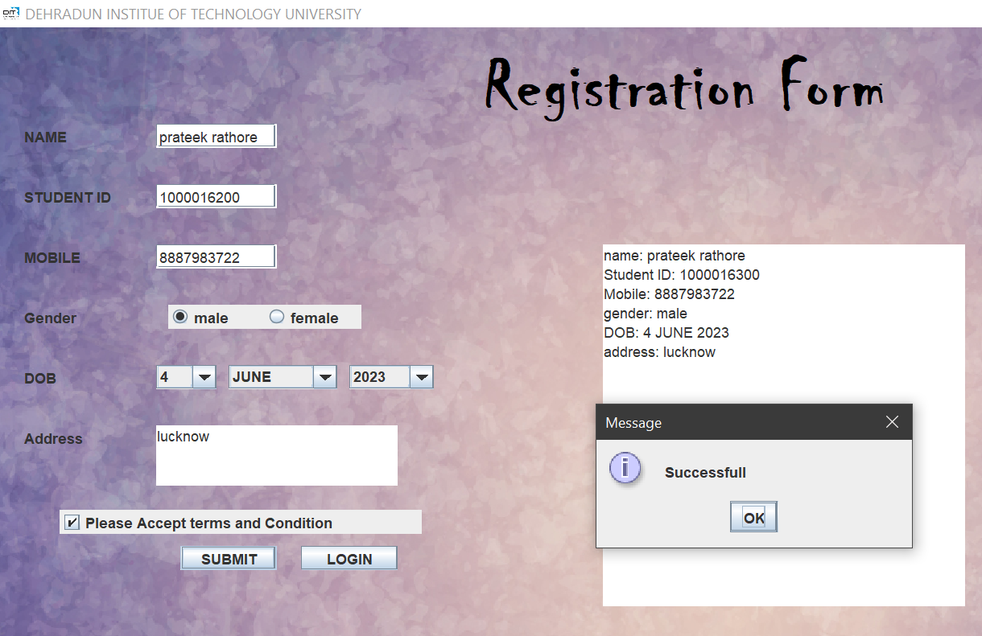
CASE 6-
If someone has already registered and is trying to register again than it will show duplicate entery.
CASE 7-
If all the entry are correct and there is no duplicate entery than it will show Registration successful

Slide 13
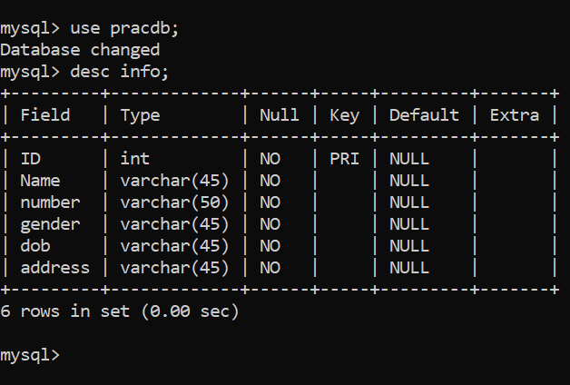
4. Create Database and table in MySql
Here I have created database named Pracdb.
Table name is info that has 5 parameters that are ID(Integer) and also a Primary key,,name(VarChar),mobile(VarChar),
gender(VarChar),dob(VarChar),address(VarChar).

Slide 14
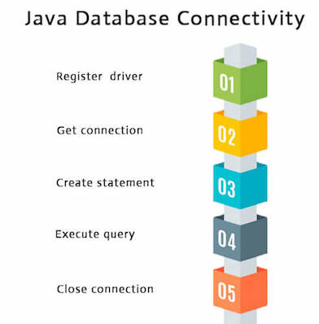
5. Link Database with Java Swing
To connect Java application with the MySQL database, we need to follow 5 following steps.
In this example we are using MySql as the database. So we need to know following informations for the mysql database:
Driver class: The driver class for the mysql database is com.mysql.jdbc.Driver.
Connection URL: The connection URL for the mysql database is jdbc:mysql://localhost:3306/sonoo where jdbc is the API, mysql is the database, localhost is the server name on which mysql is running, we may also use IP address, 3306 is the port number and sonoo is the database name. We may use any database, in such case, we need to replace the sonoo with our database name.
Username: The default username for the mysql database is root.
Password: It is the password given by the user at the time of installing the mysql database. In this example, we are going to use root as the password.
JDBC connectivity has 5 steps:
Register the Driver class
Create connection
Create statement
Execute queries
Close connection

Slide 15
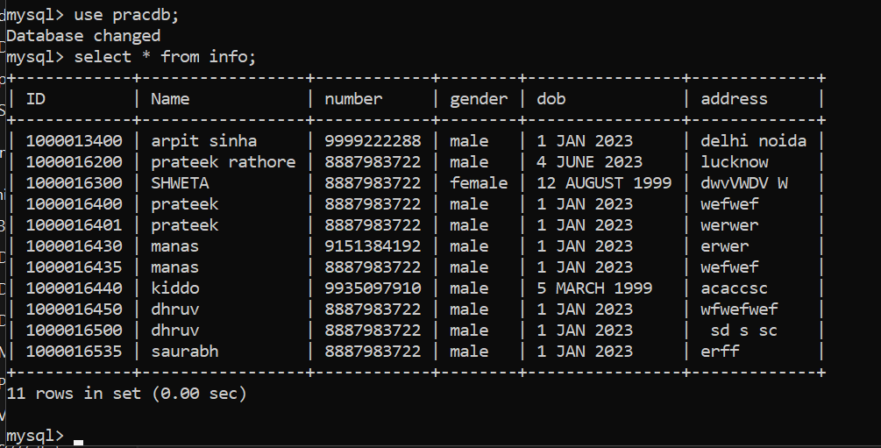
6. Saving data to MySql Database
Here data is being same in database named pracdb in form of table named info
7. Create second frame named Login to extract data from database
We have created a new frame named login where admin has to enter password to see the data from database.
LOGIN ID- adminID
LOGIN Password – adminPass
After entering correct id and pass the admin can see who all have registered.

Slide 16
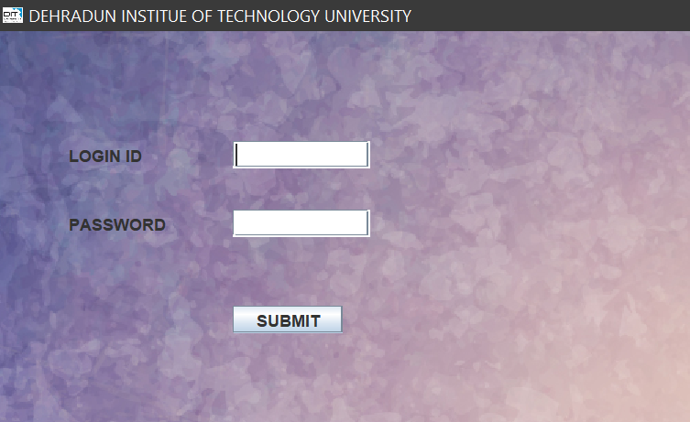
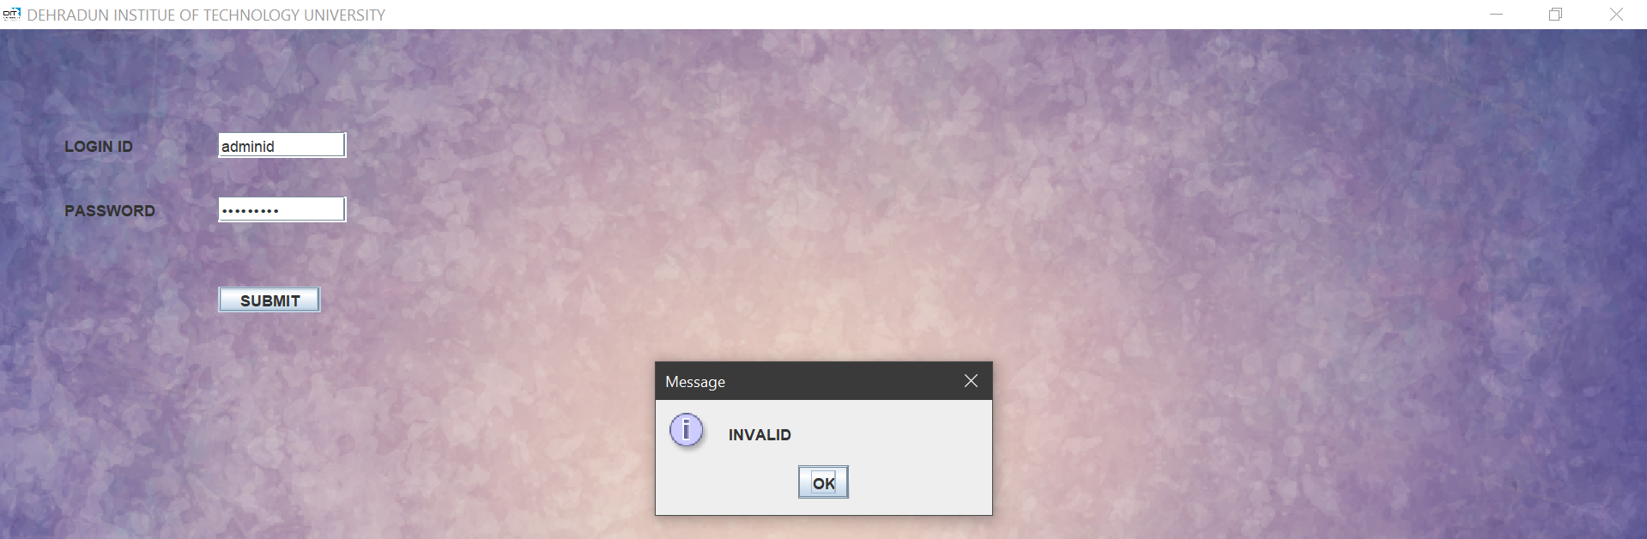
If login ID and PASSWORD in incorrect

Slide 17
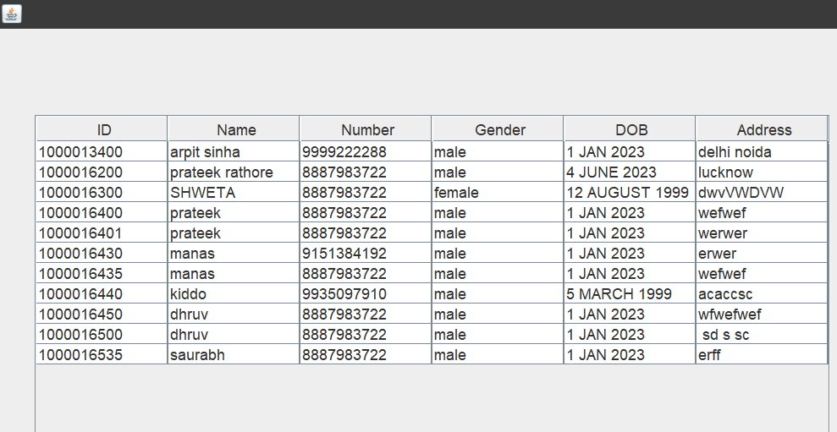
After admin has enter correct ID and Password he can see the enteries of people

Slide 18
CODE-
RegistraionForm.java
package registrationform;
import javax.swing.*;
import java.awt.*;
import java.awt.event.*;
import java.sql.Connection;
import java.sql.DriverManager;
import java.sql.PreparedStatement;
class MyFrame2 extends JFrame implements ActionListener
{
JLabel label7,label8,msg1;
JTextField t4;
JPasswordField pass;
JButton submit1;
MyFrame2(){
setDefaultCloseOperation(JFrame.EXIT_ON_CLOSE);
setBounds(700, 500, 1000, 500);
setTitle("DEHRADUN INSTITUE OF TECHNOLOGY UNIVERSITY ");
ImageIcon obj=new ImageIcon("C:\\Users\\user\\Desktop\\dit img.jpg");
setIconImage(obj.getImage());
setLayout(null);
setContentPane(new JLabel(new ImageIcon("C:\\Users\\user\\Desktop\\02-01.jpg")));
label7=new JLabel("LOGIN ID");
label7.setBounds(50,80,100,20);
add(label7);
t4=new JTextField();
t4.setBounds(170,80,100,20);
add(t4);
label8=new JLabel("PASSWORD");
label8.setBounds(50,130,100,20);
add(label8);
pass=new JPasswordField();
pass.setBounds(170,130,100,20);
add(pass);
submit1=new JButton("SUBMIT");
submit1.setBounds(170,200,80,20);
add(submit1);
submit1.addActionListener(this);

Slide 19
msg1=new JLabel("");
msg1.setBounds(50,300,250,20);
add(msg1);
setVisible(true);
}
public void actionPerformed(ActionEvent f)
{
if(((t4.getText()).equals("adminID")) && ((pass.getText()).equals("adminPass"))){
// f1.dispose();
admin ad = new admin();
ad.setVisible(true);
}else{
JOptionPane.showMessageDialog(null, "INVALID");
}
}
}
class MyFrame extends JFrame implements ActionListener
{
JLabel label1,label2,label3,label4,label5,label,label6;
JTextField t1,t2,t3;
JRadioButton male,female;
JComboBox day,month,year;
JTextArea ta1,screen;
JCheckBox terms;
JButton submit,login;
JLabel msg;
MyFrame()
{
setDefaultCloseOperation(JFrame.EXIT_ON_CLOSE);
setBounds(700, 500, 1000, 500);
setTitle("DEHRADUN INSTITUE OF TECHNOLOGY UNIVERSITY ");
ImageIcon ob=new ImageIcon("C:\\Users\\user\\Desktop\\dit img.jpg");
setIconImage(ob.getImage());
setLayout(new BorderLayout());
//for background
setContentPane(new JLabel(new ImageIcon("C:\\Users\\user\\Desktop\\02-01.jpg")));
label=new JLabel("Registration Form");
add(label);
label.setBounds(400,0,800,100);
Font font=new Font("Chiller",Font.BOLD,60);
label.setFont(font);
label.setForeground(Color.black);

Slide 20
label1=new JLabel("NAME");
label1.setBounds(20,80,100,20);
add(label1);
t1=new JTextField();
t1.setBounds(130,80,100,20);
add(t1);
label6=new JLabel("STUDENT ID");
label6.setBounds(20,130,100,20);
add(label6);
t3=new JTextField();
t3.setBounds(130,130,100,20);
add(t3);
label2=new JLabel("MOBILE");
label2.setBounds(20,180,100,20);
add(label2);
t2=new JTextField();
t2.setBounds(130,180,100,20);
add(t2);
label3=new JLabel("Gender");
label3.setBounds(20,230,100,20);
add(label3);
male=new JRadioButton("male");
female=new JRadioButton("female");
male.setBounds(140,230,80,20);
add(male);
female.setBounds(220,230,80,20);
add(female);
male.setSelected(true);
ButtonGroup gen=new ButtonGroup();
gen.add(male);
gen.add(female);
label4=new JLabel("DOB");
label4.setBounds(20,280,100,20);
add(label4);
String days[]={"1","2","3","4","5","6","7","8","9","10","11","12","13","14","15","16","17","18","19","20","21","22","23","24","25","26","27","28","29","30","31"};
String months[]={"JAN","FEB","MARCH","APRIL","MAY","JUNE","JULY","AUGUST","SEPTEMBER","OCTOBER","NOVEMBER","DECEMBER"};
String years[]={"2023","2022","2021","2020","2019","2018","2017","2016","2015","2014","2013","2012","2011","2010","2009","2008","2007","2006","2005","2004","2003","2002","2001","2000","1999","1998","1997","1996","1995"};

Slide 21
day=new JComboBox(days);
month=new JComboBox(months);
year=new JComboBox(years);
day.setBounds(130,280,50,20);
add(day);
month.setBounds(190,280,90,20);
add(month);
year.setBounds(290,280,70,20);
add(year);
label5=new JLabel("Address");
label5.setBounds(20,330,100,20);
add(label5);
ta1=new JTextArea();
ta1.setBounds(130,330,200,50);
add(ta1);
terms=new JCheckBox("Please Accept terms and Condition");
terms.setBounds(50,400,300,20);
add(terms);
submit=new JButton("SUBMIT");
submit.setBounds(150,430,80,20);
add(submit);
submit.addActionListener(this);
login=new JButton("LOGIN");
login.setBounds(250,430,80,20);
add(login);
login.addActionListener(this);
screen=new JTextArea();
screen.setBounds(500,180,300,300);
add(screen);
screen.setEditable(false);
msg=new JLabel("");
msg.setBounds(20,480,250,20);
add(msg);
setVisible(true);
}
public void actionPerformed(ActionEvent e)
{

Slide 22
if(e.getSource()==submit) // IT REGISTER STUDENT IF WE CLICK SUBMIT BUTTON
{
if(terms.isSelected())
{
String name=t1.getText();
int len1 = name.length();
String id=t3.getText();
int len3=id.length();
String mobile=t2.getText();
int len = mobile.length();
String gender="male";
if(female.isSelected()){
gender="female";}
String dob=day.getSelectedItem()+" "+month.getSelectedItem()+" "+year.getSelectedItem();
String address=ta1.getText();
int len2 = address.length();
if(len!=10){msg.setText("ENTER CORRECT MOBILE NUMBER");}
else if(len1==0){msg.setText("ENTER NAME");}
else if(len2==0){msg.setText("ENTER ADDRESS");}
else if(len3!=10){msg.setText("ENTER CORRECT STUDENT ID");}
else {
if(mobile.matches("\\d+") && onlyLettersSpaces(name) && id.matches("\\d+"))//THIS CHECK IF NUMBER ,NAME AND STUDENT ID HAS CORRECT VALUE
{
try{
Connection conn= DriverManager.getConnection("jdbc:mysql://localhost:3306/pracdb", "root", "prateek@123");
String sql = "insert into info(ID,Name,number, gender, dob, address) values(?,?,?,?,?,?)";
PreparedStatement pstmt = conn.prepareStatement(sql);
pstmt.setString(1, id);
pstmt.setString(2, name);
pstmt.setString(3, mobile);
pstmt.setString(4, gender);
pstmt.setString(5, dob);
pstmt.setString(6, address);
int i = pstmt.executeUpdate();
if(i == 1){
JOptionPane.showMessageDialog(null, "Successfull");
msg.setText("Registration Successfull");
}else{
JOptionPane.showMessageDialog(null, "Error Connecting... ");}
}
catch(Exception q){
JOptionPane.showMessageDialog(null, "Error Connecting... " + q);}
screen.setText("name: "+name+"\n"+"Student ID: "+id+"\n"+"Mobile: " +mobile+"\n"+"gender: "+gender+"\n"+"DOB: "+dob+"\n"+"address: "+address);
}
else{msg.setText("ENTER CORRECT VALUE IN FIELDS ");}
}

Slide 23
}
else{
msg.setText("Accept Terms and Conditoin");
screen.setText("");}
}
else if(e.getSource()==login) // WERE CREATING ANOTHER FRAME FOR VIEW BUTTON
{
MyFrame2 f2= new MyFrame2();
}
}
//THIS FUNC IS FOR CHECK NAME HAS ONLY ALPHABET AND SPACES
public static boolean onlyLettersSpaces(String name)
{
for(int i=0;i<name.length();i++){
char ch = name.charAt(i);
if (Character.isLetter(ch) || ch == ' ') {
continue;}
return false;}
return true;
}
}
public class RegistrationForm{
public static void main(String args[]){
MyFrame f=new MyFrame();
}
}
2. Admin.java
package registrationform;
import java.sql.*;
import java.util.Vector;
import javax.swing.JOptionPane;
import javax.swing.plaf.basic.BasicInternalFrameUI;
import javax.swing.table.DefaultTableModel;
public class admin extends javax.swing.JFrame {
public admin() {
initComponents();
//this.setBorder(null);
// BasicInternalFrameUI bui = (BasicInternalFrameUI) this.getUI();
// bui.setNorthPane(null);
fetch(); }

Slide 24
public void fetch()
{
try{
//Class.forName("com.mysql.jdbc.Driver");
Connection conn= DriverManager.getConnection("jdbc:mysql://localhost:3306/pracdb", "root", "prateek@123");
String sql2="select id, name, number, gender, dob, address from info";
PreparedStatement pstmt2=conn.prepareStatement(sql2);
//pstmt2.setString(1, cartid.getText());
ResultSet rs=pstmt2.executeQuery();
ResultSetMetaData rsmd = rs.getMetaData();
int n = rsmd.getColumnCount();
DefaultTableModel model = (DefaultTableModel) userTable.getModel();
model.setRowCount(0);
while(rs.next()){
Vector v = new Vector();
for(int i=1; i<n; i++){
v.add(rs.getString("ID"));
v.add(rs.getString("Name"));
v.add(rs.getString("number"));
v.add(rs.getString("gender"));
v.add(rs.getString("dob"));
v.add(rs.getString("address"));
}
model.addRow(v);
}
}catch(SQLException e){
JOptionPane.showMessageDialog(null, e);
}
}
public static void main(String args[]) {
java.awt.EventQueue.invokeLater(new Runnable() {
public void run() {
new admin().setVisible(true);
}
});
}
// Variables declaration - do not modify
private javax.swing.JPanel jPanel1;
private javax.swing.JScrollPane jScrollPane1;
private javax.swing.JTable userTable;
// End of variables declaration
}

